Slide 2
Data Science Unit 1
Introduction to Python
Notes:
We have set up our environment and now we can start coding! For each of these sessions we will be flipping between this slide deck and the notebook you should find in the folder you extracted

Slide 3



Python
Notes:
Python was invented in the early 90’s by Guido Van Rossum. It is a programming language that is designed to be easily read (by both humans and machines) that makes use of an object-orientated approach so developers can write clear, concise code for projects of any size. We are now using python version 3.

Slide 4





Python
Notes:
A major reason we use python for data science is the wide range of packages that have been created to help support our work. We will look at many of these throughout this bootcamp. Other benefits of python is that it is open source (anyone can use it/contribute- hence the abundance of libraries) and it can be used for a wide variety of reasons (dropbox is famously built in python).

Slide 5
Data Science Unit 1
Data Types and Operators
Notes:
Let’s start learning about some code! For this section you can open the notebook ‘python_dtypes’ so you can code along, we will flip between the two throughout. Go to section 1.
The first thing we need to understand about coding is the different ways data can be given to us

Slide 6
Data Types
Data Type | Definition | Example
Integer | Whole numbers given from negative infinity to infinity | 5, 3, -1, 1000
Float | ‘Floating point number’ – has a decimal point in it | 3.3, -2.4, 5.0
String | A set of letters, numbers or characters in general – surrounded by quotation marks | ‘Data is Awesome’
Tuple | Ordered sequence with fixed number of elements- surrounded by parenthesis | (1,2), (‘Red’, ‘Green’, ‘Blue’)
List | Ordered sequence with no fixed number of elements- surrounded by square brackets | [1,2], [‘Red’, ‘Green’, ‘Blue]
Dictionary | Unordered collection of key value pairs. To access the value you need to use its key | {‘Blue’:5, ‘Red’ :2, ‘Green’:0}
Notes:
We will be coming back to some of these in more detail.
[Coach go to section 1 of notebook and demonstrate code along- point out common functions like ‘type’ and ‘print’]- point out how to run a cell and also how to add/delete
Sidenote for coaches: In Python version 3.7+, dictionaries are ordered. It would be worth mentioning as a side note that dictionaries may be ordered or unordered depending on which Python version the apprentice is using. An external resource to confirm this: https://medium.com/junior-dev/python-dictionaries-are-ordered-now-but-how-and-why-5d5a40ee327f

Slide 7
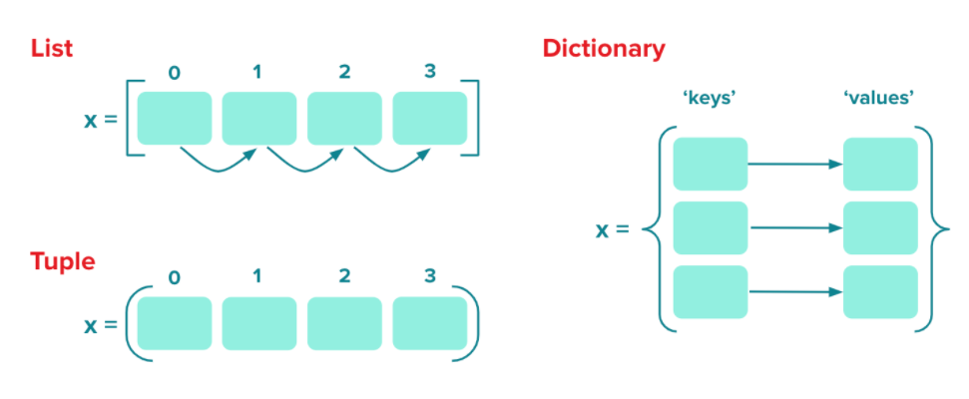
Collections
Notes:
To help us understand the difference between a list, tuple and dictionary
The Key Difference between a List and a Tuple. The main difference between lists and tuples is the fact that lists are mutable whereas tuples are immutable. ... A mutable data type means that a python object of this type can be modified. An immutable object can't.

Slide 8
Variables
Restrictions
Variable names cannot be just a number (i.e., 2, 0.01, 10000).
Variables cannot be assigned the same name as a default or imported function (i.e., 'type', 'print', 'for').
Variable names cannot contain spaces.
Best Practices
Variable names should be lowercase.
A variable's name should be representative of the value(s) it has been assigned.
If you must use multiple words in your variable name, use an underscore to separate them.
Notes:
Variables are names that have been assigned to pieces of data, and can be called almost anything you want- but there are a few rules...

Slide 9
Operators
Operator | What it does | Example
+ | Adds | 1 + 1 = 2
- | Subtracts | 3 - 2 = 1
* | Multiplies | 4 * 4 = 16
/ | Divides | 5/2 = 2.5
// | Quotient (after division rounds down to whole number) | 5//2 = 2
** | Exponent | 3 ** 2 = 9
= | Assigns value | x = 2
% | Modulo (finds remainder) | 5 % 2 = 1
Notes:
Like SQL, Python has several operators we can use, the table shows some of the more common. [Demo operators section].
Challenge- play countdown, set some numbers and a target and ask apprentices to find a solution using python

Slide 10

Booleans
x = 2
Boolean | Outcome
x is 2 | True
x is 4 | False
x is 2 and x is 4 | False
x is not 2 | False
x is 2 or x is 4 | True
Notes:
Booleans are binary response, True or False. We can use them as a means of evaluation. Let’s say x=2 and then make some statements, what would the outcomes be?

Slide 11
Comparisons
Operator | What it does
== | Equals to
!= | Not equals to
> | Greater than
>= | Greater than or equals to
< | Less than
<= | Less than or equals to
Notes:
We also have logical comparison operators as well we can make use of

Slide 12
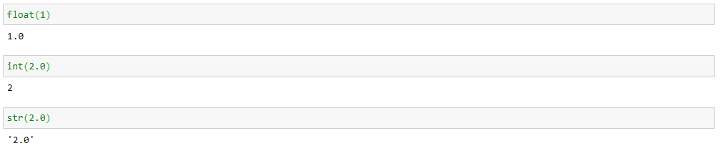
Changing Types
Notes:
It’s simple to change data types (as long as the transition is valid- you can’t make ‘garage’ into an integer…). Note, if you make a float into an integer it will round down (truncate)

Slide 13
Data Science Unit 1
Strings and Indexing
Notes:
Essentially strings are just characters between quotation marks. We are going to learn now how to apply various operations to strings.

Slide 14
String
‘Hello World’
0 1 2 3 4 5 6 7 8 9 10
Notes:
A string is a collection of characters between quotation marks, but note the order means nothing to a computer. It justs sees the characters and has no understanding that the order means anything.
What it does understand is the order, which is called indexing. A characters position in a string can be called by its index, note, the first character is at index 0. This is common across python as we will see where the first item is at position 0. Also note the white space between Hello and World has an index too.
There are other functions we can do as well such as replace or concatenate to manipulate strings. Let’s head to section 2 of the notebook to explore some of these.

Slide 15
List
[‘Data’, 1, ‘London’, 2.0]
Notes:
A list is an unordered sequence of data which can contain different data types, although it is good practice to make it consistent (e.g. if all items are integers we can write one line of code to run a calculation on the entire list]. Lists are indexed the same way as strings (starting from 0) and there are many operations we can do to work with them! For example, we can add or remove values, change values or slice.
head to Section 3: Lists and explore the different things we can do.

Slide 16
Data Science Unit 1
Collections
Notes:
In section 3 we will review lists, tuples and dictionaries- 3 important ways we can sequence items together.

Slide 17
Tuples
(1,2,3)
Notes:
A tuple is similar to a list, except it cannot be changed. You cannot add in or remove items but you can unpack them. Go to section 4: tuples to explore.

Slide 18
Dictionary
{‘A’:2, ‘B’:5, ‘C’:10}
Notes:
A dictionary is similar to a list, but instead of using an index we use key values. The item before the colon is the key and the item after is the value. Dictionaries can be manipulated in many ways, head to section 5: dictionaries to see many of these tricks.

Slide 19
Data Science Unit 1
Importing Libraries
Notes:
Python is an open source language,meaning anyone can contribute to it. Over the years some impressive programmers have made invaluable contributions, creating libraries we can use for our analysis, saving us from writing the code ourselves.

Slide 20
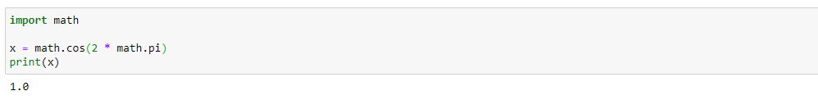
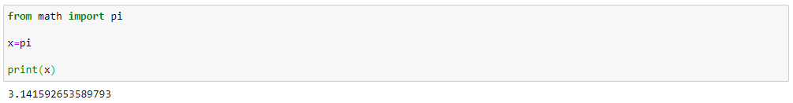
Import
Notes:
Importing libraries is simple- you type import followed by whatever library you want. If you need to use a specific function, either you can use it by library.function or importing the function directly.
Note: You do need to be careful when importing libraries that you are not in breach of company policies. Many libraries are pre built into python and as such can be used. Others you will need to install onto your computer first, so check with your ITpolicy that you can do this or you could get into trouble. Follow the same steps you would to install a new piece of software.
Head to section 6 to demonstrate

Slide 21
Data Science Unit 1
Practice
Notes:
Pair up and make up your own statements using strings, lists, indexing, and concatenation, as well as other Python elements discussed in this lesson. See if your partner can tell you what will be returned BEFORE running it.

Slide 22
Data Science Unit 1
Control Flow
Notes:
We have so far looked at how to define variables and collections in python, but how do we use them? In this section we will be looking at logical statements and how to set up a loop. For this section we will be using python-controlflow notebook.

Slide 23


Control Flow
Notes:
Control flow is the process of creating a script that will logically and sequentially follow. We will be looking at if/else statements and different types of loops, combining them to interact with our data.

Slide 24
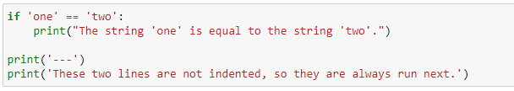
Indentation
Notes:
Before we begin, a quick word on indenting. In python it is important to indent our code (it won’t run otherwise), when we define a statement we finish it with a colon, the next line will then be indented to show it is part of that statement.

Slide 25
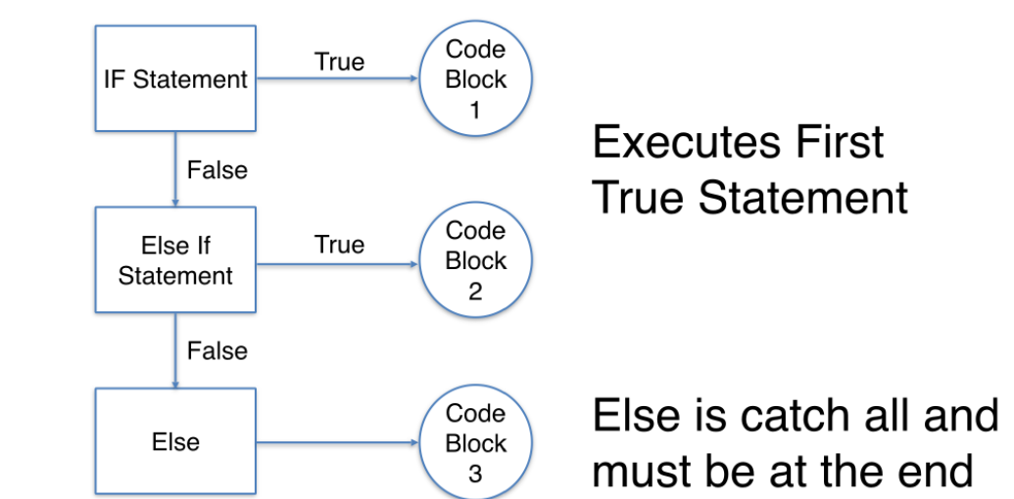
If/else
Notes:
An if/else statements are the most basic blocks and similar to what we have seen in Excel, SQL and Tableau. Essentially, if the first statement is true we execute that code, otherwise we move onto the next statement. Note, the order of statements is important as python will sequentially work through them. Go to section 1 of notebook to demonstrate and either demo or allow apprentices to have a go at the two questions.

Slide 26
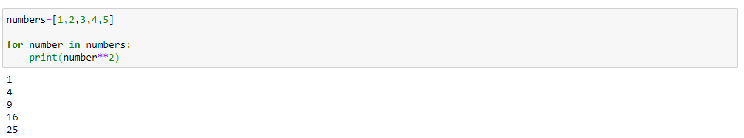
For
Notes:
One of the reasons we use python is because it enables us to automate repetitive tasks, for example if we wanted to square every number in a list we could write a for loop that selects each item and squares it. Go to section 2: for loops and demo example and allow apprentices to attempt the questions

Slide 27
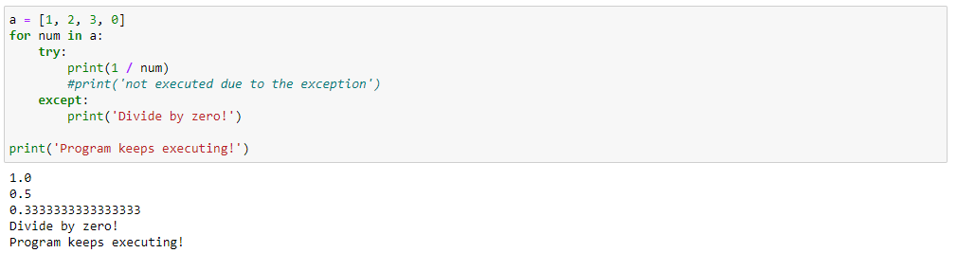
try-except
Notes:
One of the most frustrating parts of coding is errors, you try to do something and it just breaks. This is especially annoying when writing a loop as it will break the whole loop, probably not saving everything it did before. For example, you may accidentally divide by 0 or try to convert a string to an integer which isn’t possible!
To help us with this we can use try-except. Similar to if/else, python will try to do some calculation and if it fails will move to the except. It is very common to see several try-except clauses in blocks of good as a way of avoiding bugs. Go to section 3 try-except.

Slide 28
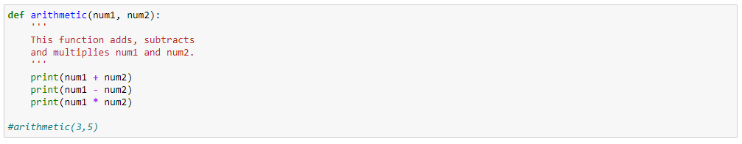
Functions
Notes:
A function is another powerful way we can automate tasks. Let’s say for example, you want to square a number and then add 5. You can write the block of code then change the input number each time- or you could write a function that performs the calculation and call it each time it is needed, including in a for loop! Head to section 4: functions for a demonstration and some practice. [Coach draw attention to the def statement]

Slide 29
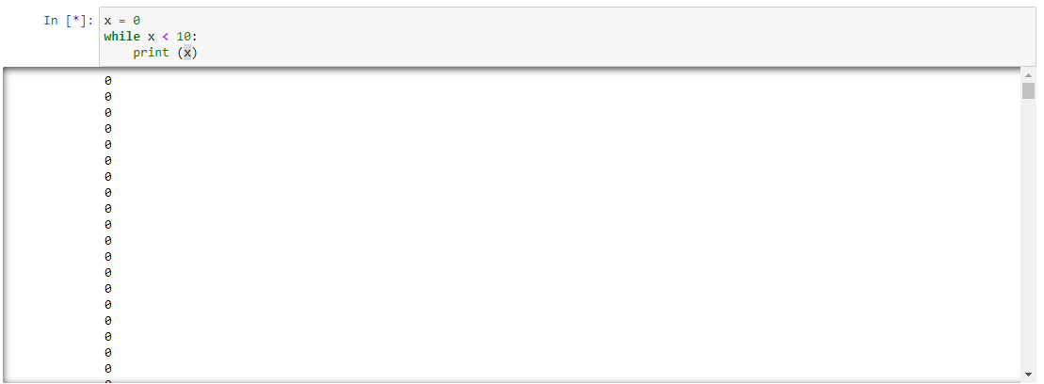
While
Notes:
Similar to for loops we have while loops. The difference is that for loops act over a finite range, while loops act until a condition is met. This means that if you are not careful, a while loop can run forever! Note the asterisk next to the input, this indicates that the code is running. Very long scripts will show this while it is computing, but if it never goes away it is an infinite loop. To fix it you would add a line such as x=x+1 so each iteration x changes until it hits 10. If you do get into an infinite loop you can break it by either restarting the kernel or pressing the stop button. Go to section 5: while loops and demo.

Slide 30
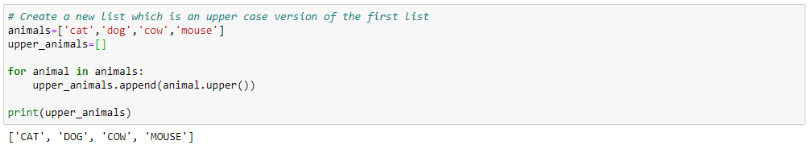
List and Dictionary Comprehensions
Notes:
Finally, is the list and dictionary comprehension. Often when we write loops we want to store the output in a list or dictionary. We can do this by writing a block of code which appends the output at the end of each loop, or writing the block of code within the list so it does both at the same time. We can do something similar with dictionaries, head to section 6 to see an example and have a go at writing some.

Slide 31
Data Science Unit 1
Practice
Notes:
Complete the exercise at the bottom of the notebook.
If apprentices are struggling, they can do types-lists-dictionaries review
When finished apprentices can do python-functions
If they finish that they can start on assignment python-movies-lab or send them to code_wars and get them to practice writing functions

